Slide 2
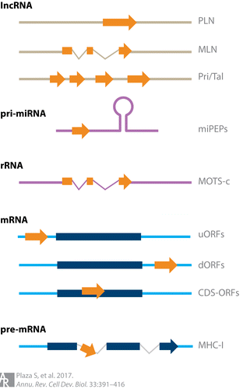
smORFs
translated small/short open reading frames
encoded within
mRNAs
introns of pre-mRNAs
lncRNAs
primary transcripts of miRNAs or rRNAs
Roles
control of various cellular processes
regulate protein levels
upstream smORFs (uORFs) regulate downstream main ORF

Slide 3
research of novel SEPs at a genome-wide scale
metrics
evolutionary conservation (using K_{a}/K_{s}, the ratio of conservative versus nonconservative nucleotide changes)
synteny (colocalization of genetic loci)
evidence of transcription
sORF finder
conservation at the amino acid level
coding potential classification based on machine learning approaches

Slide 4
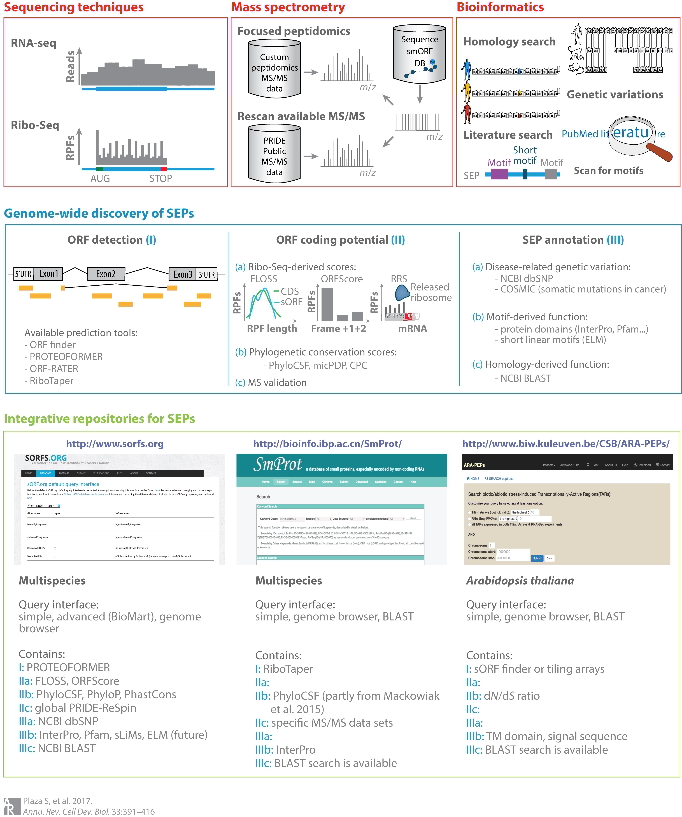

Slide 5
Translation profiling via ribosomes
Ribosome profiling
map the translatome
sequencing ribosome-protected fragments (RPFs)
Poly-Ribo-Seq
polysomes (clusters of multiple ribosomes that bind mRNA)
ultradeep sequencing of ribosome-associated RNAs

Slide 6
Bioinformatics for ribosome profiling
bioinformatic packages for predicting functional ORFs
ORF-RATER (Fields et al. 2015)
RiboTaper (Calviello et al. 2016)
SPECtre (Chun et al. 2016)
PROTEOFORMER (Crappe et al. 2015)
coding potential of detected (sm)ORFs based on Ribo-seq
ORFScore (Bazzini et al. 2014)
ribosome phasing
triplet periodic manner of translation implies that RPFs should be allocated to the first frame of a given coding sequence.
The fragment length organization similarity score (FLOSS)
bioinformatically analyzes ribosome footprints to distinguish between true coding versus noncoding regions (Ingolia et al. 2014).
ribosome release score (RRS)
ribosome disengagement at the stop codon (Guttman et al. 2013).
combined with phylogenetic conservation measurements,
CPC (Kong et al. 2007)
PhyloCSF (Lin et al. 2011)
micPDP (Bazzini et al. 2014)

Slide 7
MS-based identification of SEPs
Challenging due to small size and possible low abundance/stability
peptidomics, combined with a peptide-to-spectrum matching strategy based on RNA-seq data
affinity-based approach to enrich for cysteine-containing peptides
mining available MS fragmentation spectra in public repositories
[e.g., PRIDE (Vizcaino et al. 2016)]
cross-validate Ribo-Seq data (Olexiouk et al. 2016).

Slide 8
web-based resources
The sORFs.org repository
http://sORFs.org
ribosome profiling evidence
assesses coding potential
computational metrics and MS-based proteogenomics scanning.
functional annotations
homology and overlap with variant information.
SmProt
http://bioinfo.ibp.ac.cn/SmProt/
integrated computational pipeline based on purifying selection signatures at the amino acid level.
yeast, fruit fly, zebrafish, mouse, and human
ARA-PEPs
http://www.biw.kuleuven.be/CSB/ARA-PEPs
Arabidopsis
HAltORF
a database of predicted out-of-frame alternative ORFs
https://openprot.org/p/about
RPFdb
a database of processed Ribo-Seq data sets
http://sysbio.sysu.edu.cn/rpfdb/index.html
GWIPS-viz
a genome browser for Ribo-Seq data
http://gwips.ucc.ie/

